Slide 1
Cram-Query: Image-Processing with a modern workflow
By Doug Pagani

Slide 2
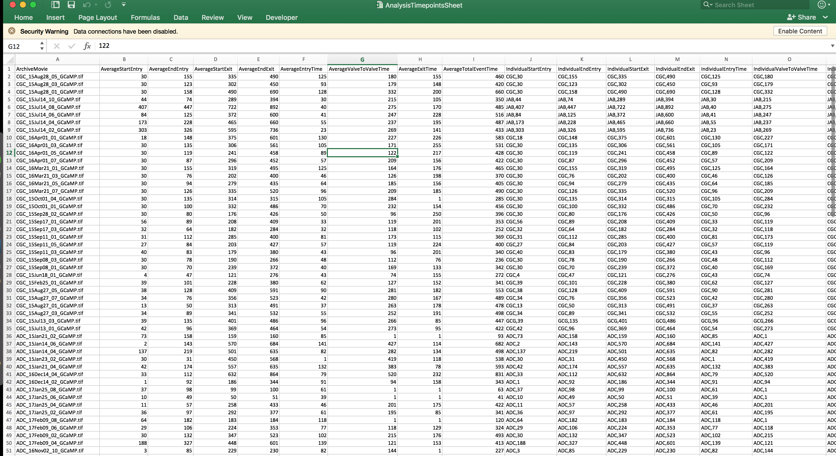
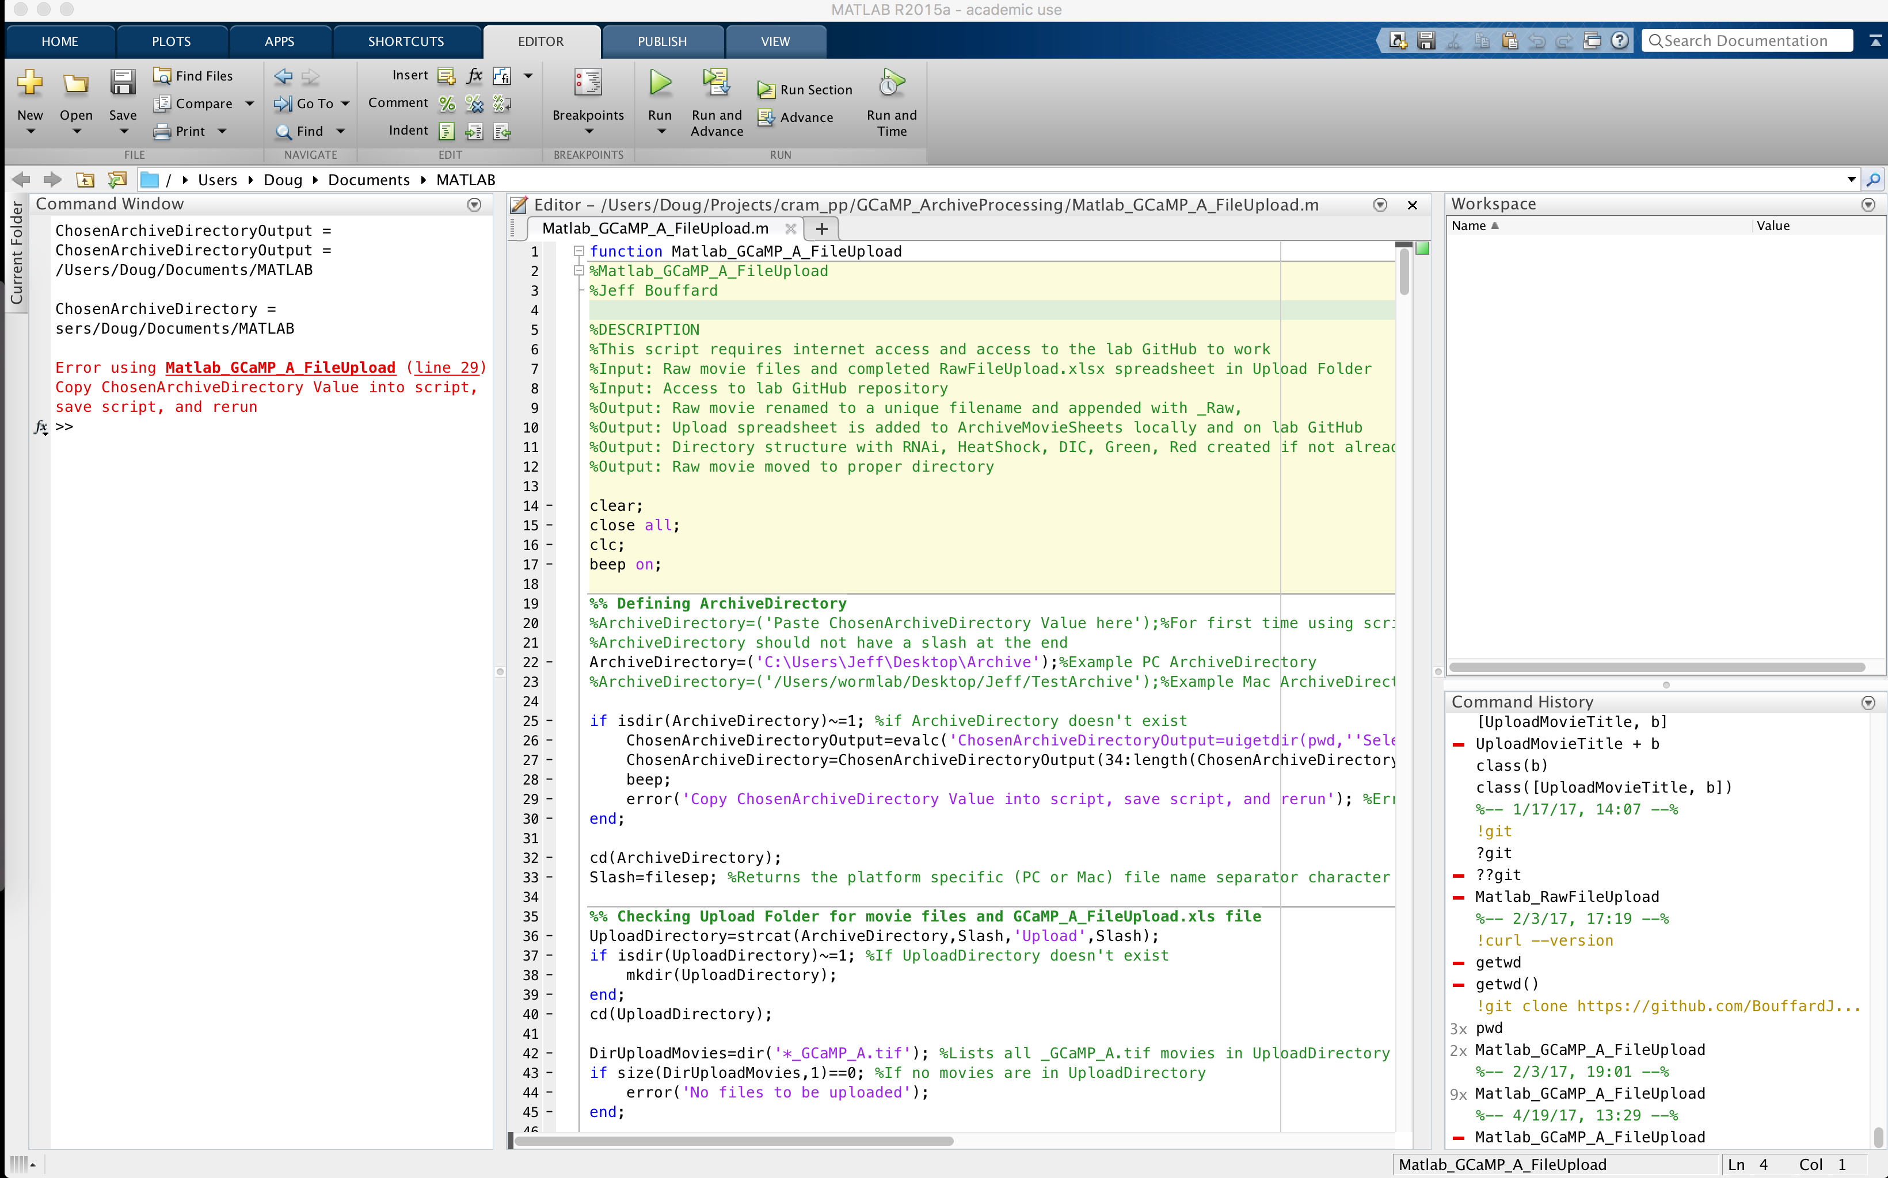

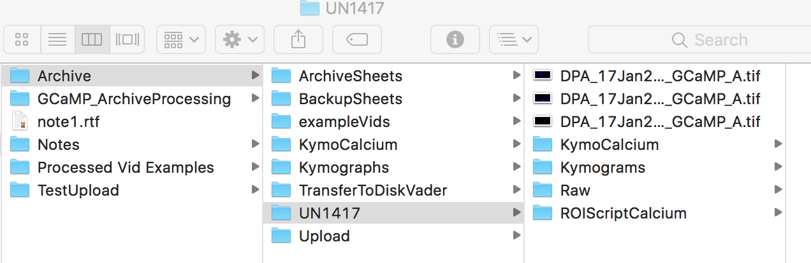
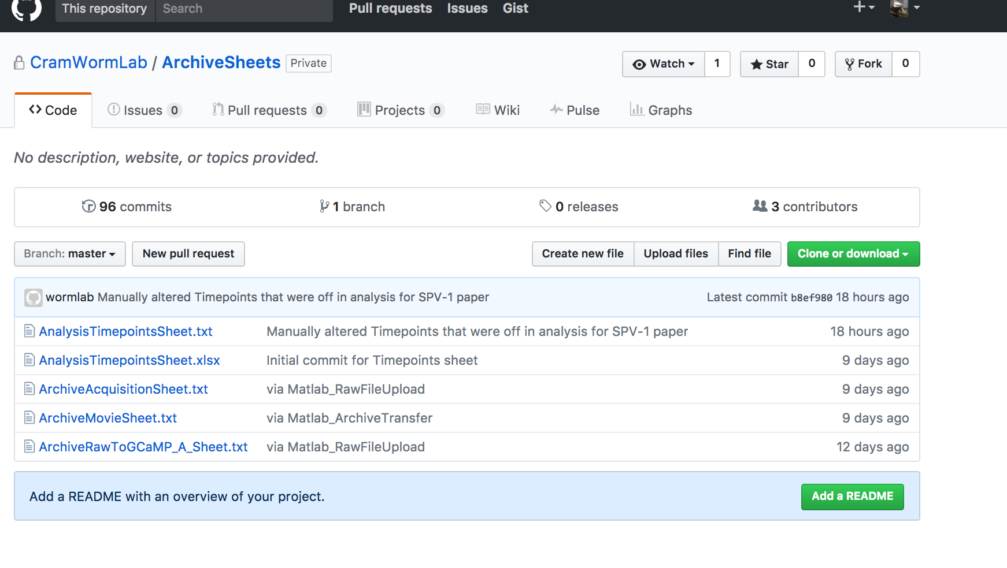
Current Process:

Slide 3
Problems:
Inability to Query
Anyone can modify both the lab’s records and the data (repository of images)
Very slow, tedious process for File-Retrieval
Un-Programmatic, Non-modular
Lack of Data-Consistency
Tedious process for Timepoint-analysis
Solely dependent on the memory of each scientist

Slide 4
3-Part Solution:
Image-Processing Pipeline (ImageJ Macro)
Video-metadata Database (MySQL)
Analytics Dashboard (RShiny)

Slide 5
Current Features:
Comprehensive Schema reflective of the domain-area
Stored Procedures for data & user validation
Secure creation of users & storage of passwords
Storage of salt & hashed passwords
Utilization of session-variable-contingent functionality
In-house security – user-level control of videos & their records

Slide 6
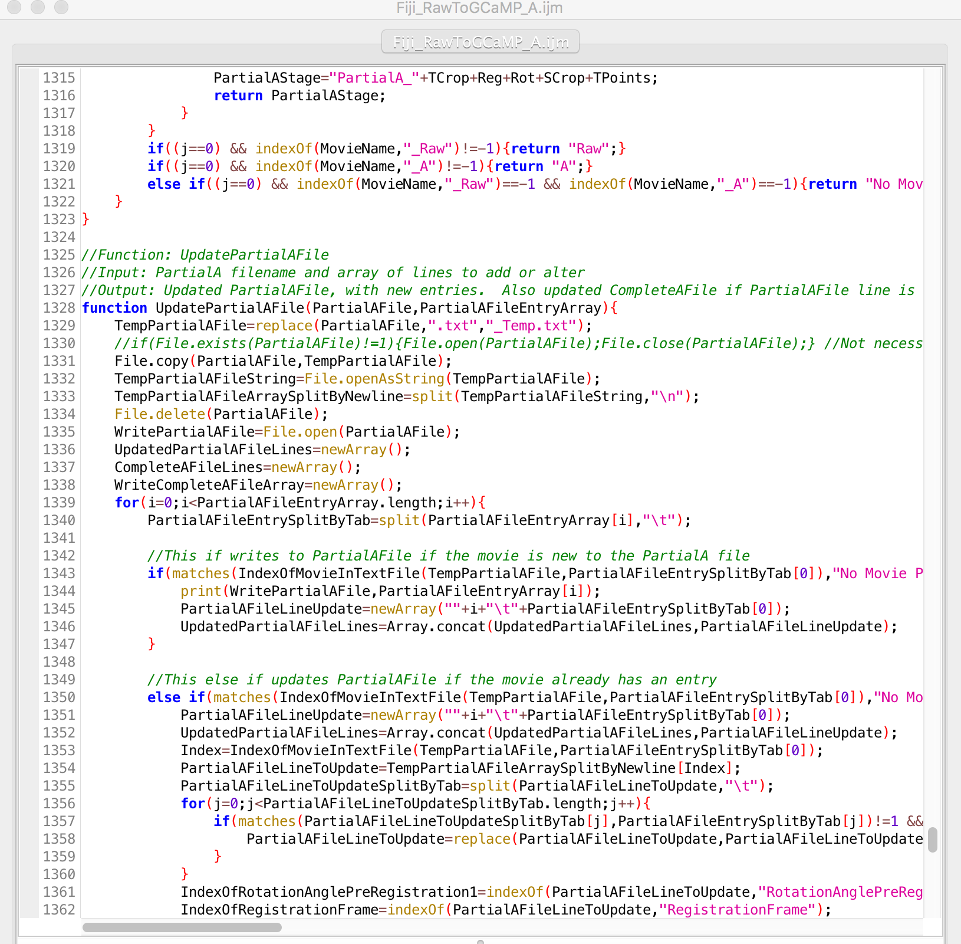
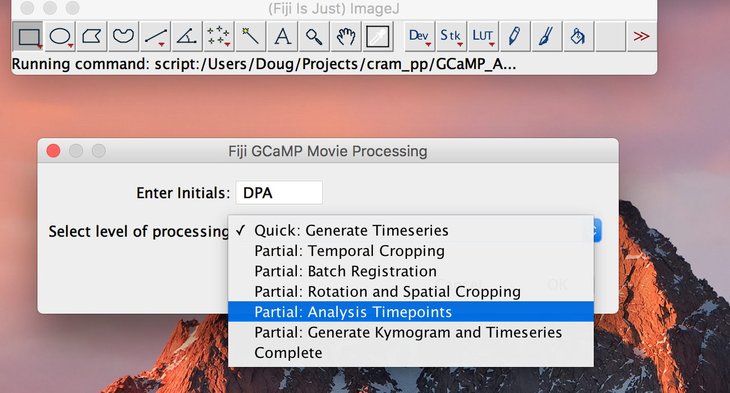
1: Fiji Macro Walkthrough

Slide 7
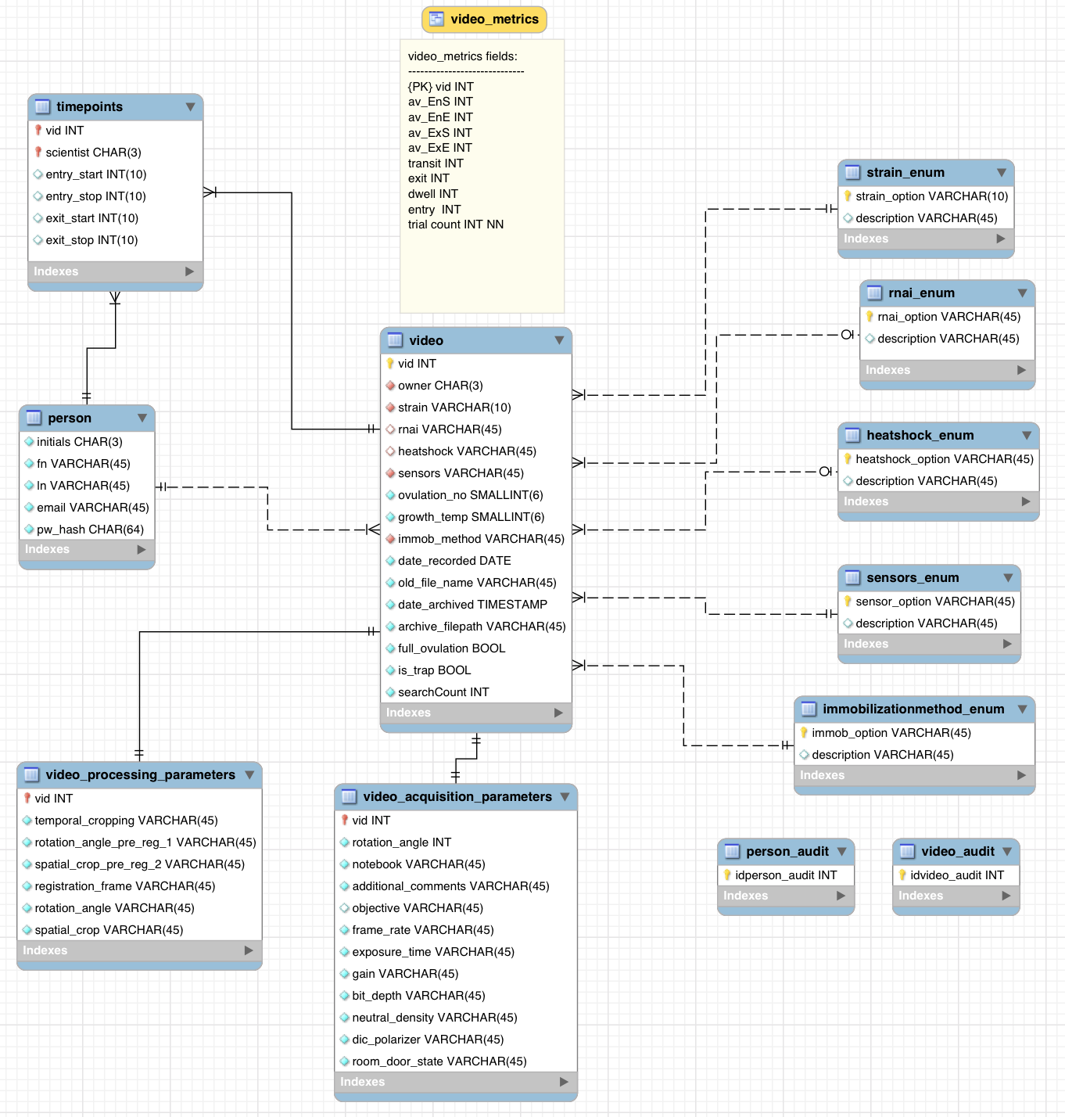

Slide 8
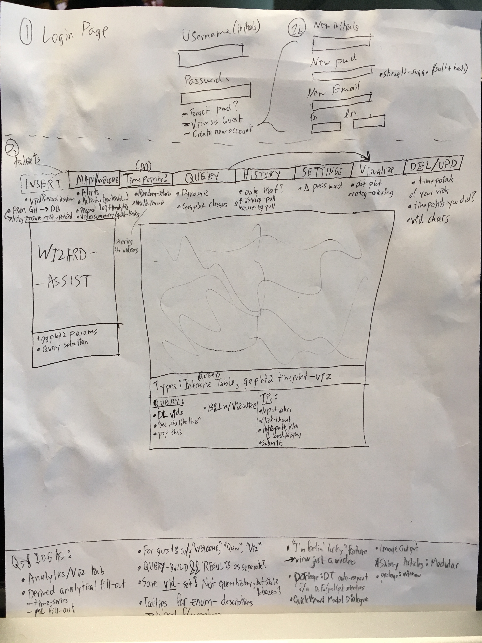

Slide 9
Future Developments:
Integrate the full data-set
Text-parsing functions, Data Transformation
Data cleaning & Enumerative-Factorization
Remote Access: Move into The Cloud (utilizing AWS)
Making use of the tagged-dataset – Machine-learning enabled spectral feature-detection
Implementation, Teaching, User-testing & UX-refinement
Thorough review of the data schema
Administrator dashboard for the Principal Investigator (Dr. Cram)
User-level & Record-level audit-log
Complex Queries, range-based
Query History & Saving of Snapshots (Search-params VS “stale data”)
ggplot-enabled time-metrics visualization (R-package for convenient data analytics)
Re-design of video-file storage (Hierarchical/ File-system → document-DB)
Confident & Consistent Backup plan

